Slide 1

CAPSTONE PROJECT
Play Store App Review Analysis
BY
Name : Jyoti Hedau
Email: hedaujyoti2064@gmail.com
Data Analyst

Slide 2


What is Google Play ?
Google’s official APP Store for Android Devices Google Play is a digital distribution service. It offers apps, books, magazines, music, movies and TV programs.

Slide 3


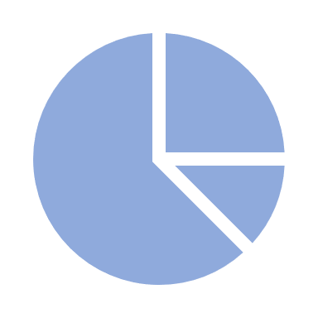




Why analyze google play store data?
Analyze the most popular apps in the most popular category.
Assess the number of installations per category.
Explore the relationship between two continuous variables in the dataset.
Determine the most popular categories of apps.
Explore the Distribution of app ratings.
Identify the distribution of paid and free apps.

Slide 4
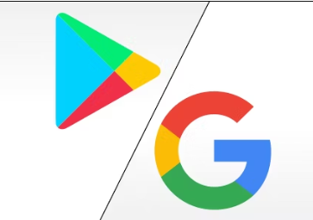
INTRODUCTION
Android is the most popular operating system in the world, with over 2.5 billion active users spanning over 190 countries
Google Play was launched on March 6, 2012, bringing together Android Market marking a shift in Google's digital distribution strategy.
Android is the dominant mobile operating system today more than 85% of all mobile devices running Google’s OS. The Google Play Store is the largest and most popular Android app store.
There are more than 3.04 million apps found on Google Play Store.
The Play Store apps data has enormous potential to drive app-making businesses to success.
Many app are being Developed as apps are easy to create and its lucrative but it is important for Developers to know which apps are loved by customer and Trending in market so that he develop only those Apps and also there is high completion between app providers producing similar application.

Slide 5
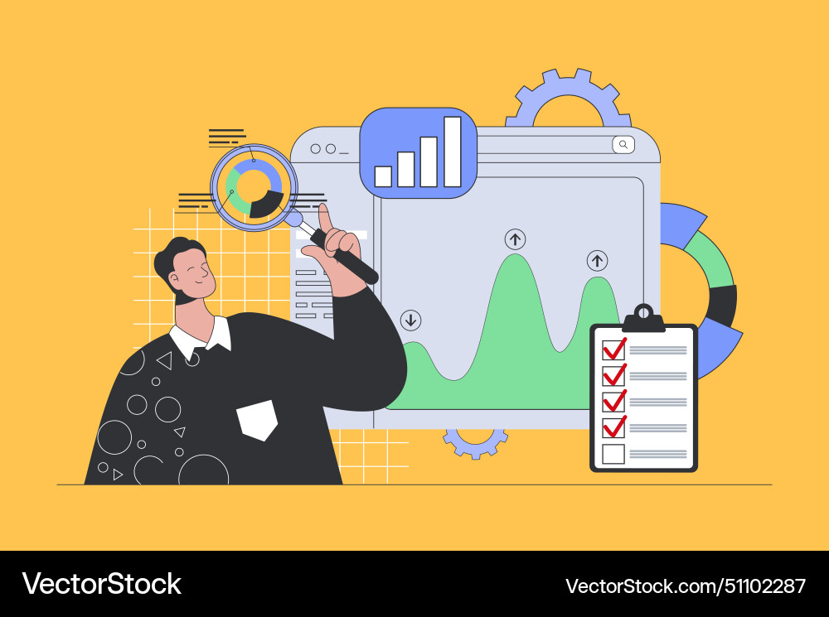
Data Preparation
Import Libraries: NumPy, Pandas, Seaborn and Matplotlib
Data cleaning: Null values, Finding and removing Outliers, Removing duplicate data.
Data Visualization: Bar Chart, Line Chart, Plot Chart, Pie Chart.
Data Imputation: Filling the missing categorical values with mode and numerical values with median. Conversion of price, installs, reviews into numerical values
Exploratory Data Analysis: Analyzing the data sets to summarize their main characteristics using statistical graphics and data visualizations method.

Slide 6

Contents of Google Play Store Data
App
Category
Rating
Reviews
Size
Installs
Type
Price
Content Rating
Genre
Last Updated
Current Version
Android Version
Sentiment
Sentiment Polarity
Sentiment Subjectivity

Slide 7
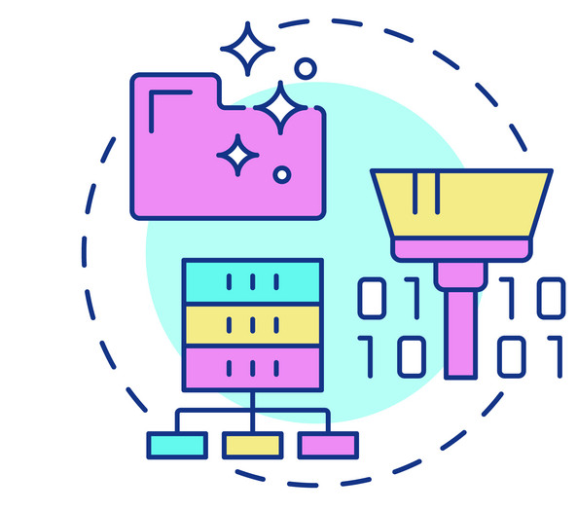
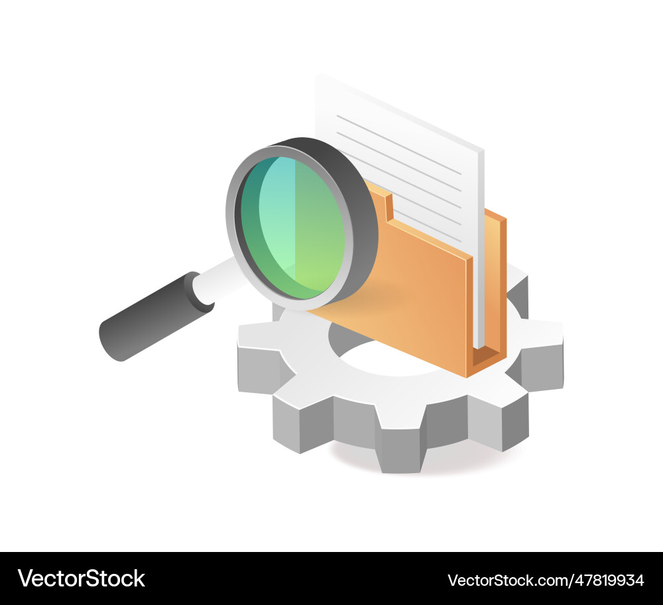
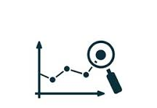
Overview of Analysis
Data Cleaning
Exploratory Data
Predictive modelling
Apply appropriate statistical methods or modeling techniques to answer the defined questions
Address missing values, handle outliers, and transform the data into a usable format. Cleaning and preprocessing steps are crucial for ensuring the accuracy and reliability of the analysis
Conduct exploratory analysis to understand the characteristics of the data. Visualize distributions, identify patterns, and calculate summary statistics. EDA helps in formulating hypotheses and refining the analysis approach

Slide 8
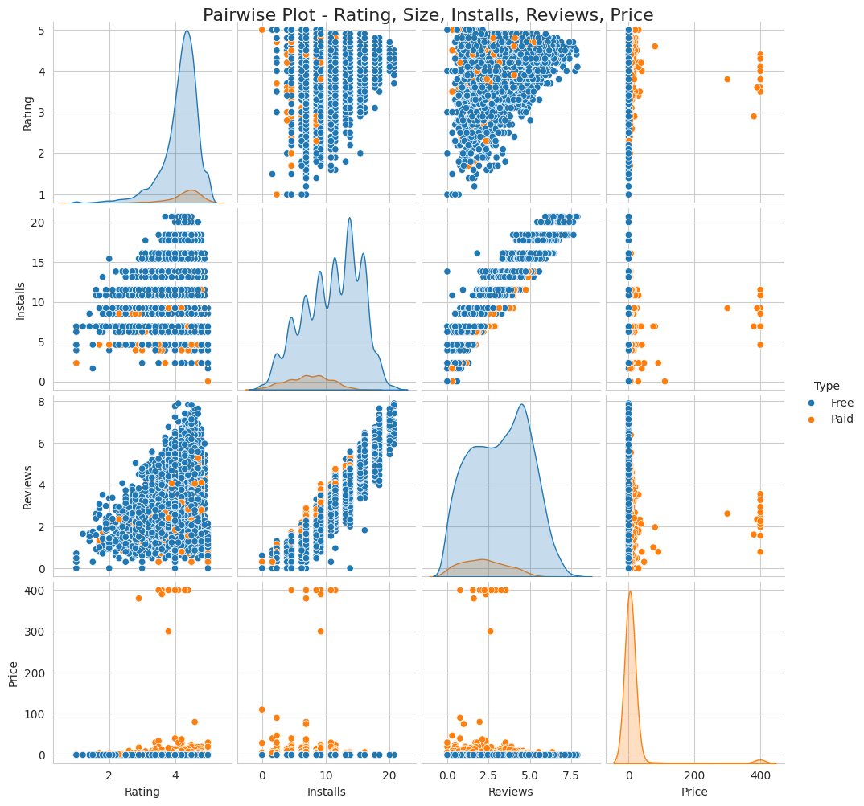
Pairwise plot-Rating, Size, Installs, Reviews, Price

Slide 9
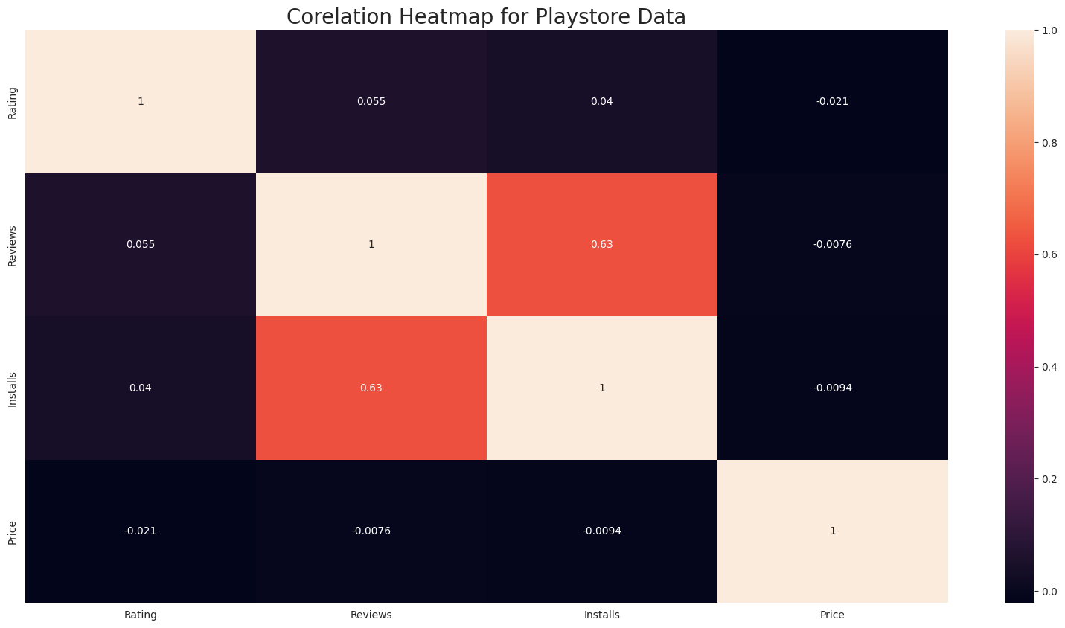
Correlation Heatmap
There is a strong positive correlation between the Reviews and Installs.
The Price is slightly negatively correlated with the Rating Reviews and Installs
The Rating is slightly positively correlated with the Installs and Reviews.

Slide 10
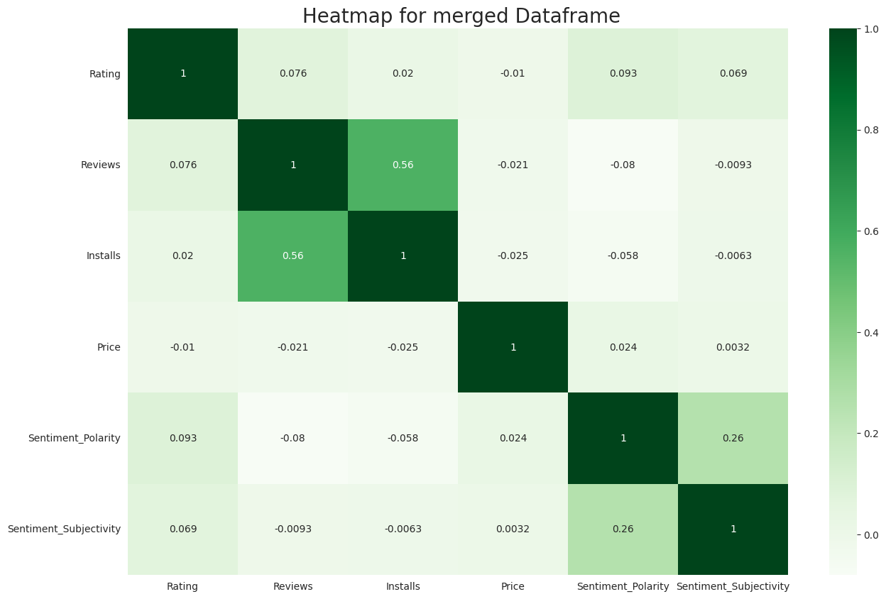
Co-Relation in merged data frame
In this correlation matrix, There is not a significant relationship between Rating, Reviews, Size and Installs with respect to the Sentiment polarity and Sentiment subjectivity.

Slide 11
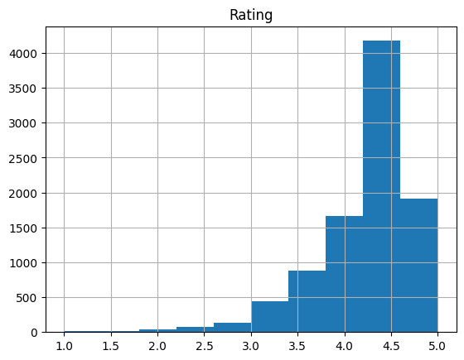
Histogram

Slide 12
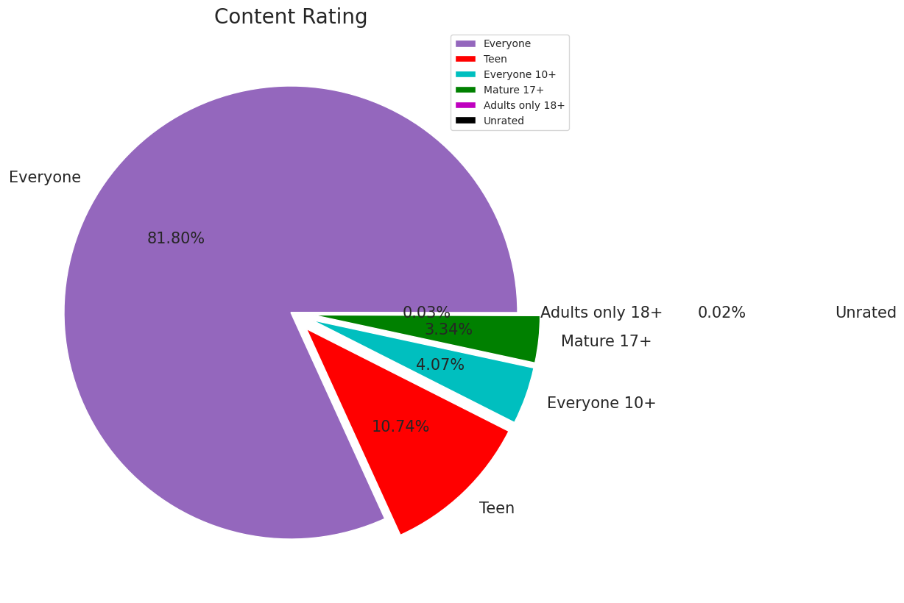
Content Rating
From the above plot we can see that Everyone category having majority of apps count.
A majority of the apps (81.80%) in the play store are can be used by everyone. The remaining apps have various age restrictions to use it.

Slide 13
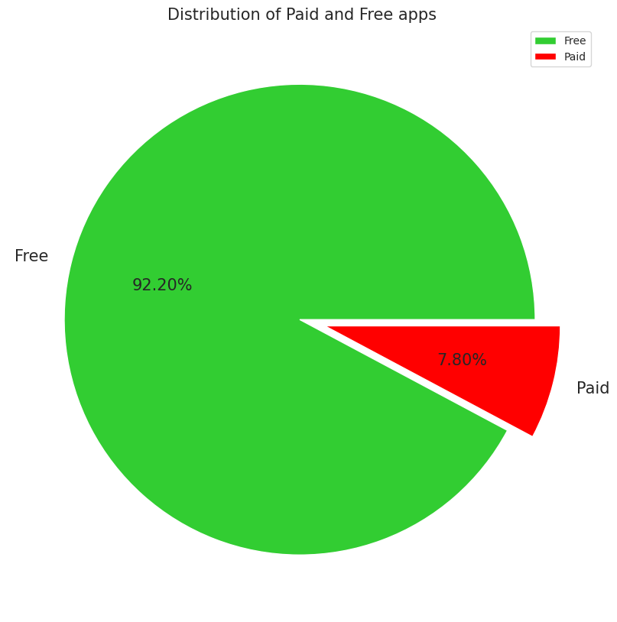
Percentage of Paid apps v/s Free apps
We Observed that 92.20% of Apps are free and only 7.80% of Apps are paid in Play store.

Slide 14
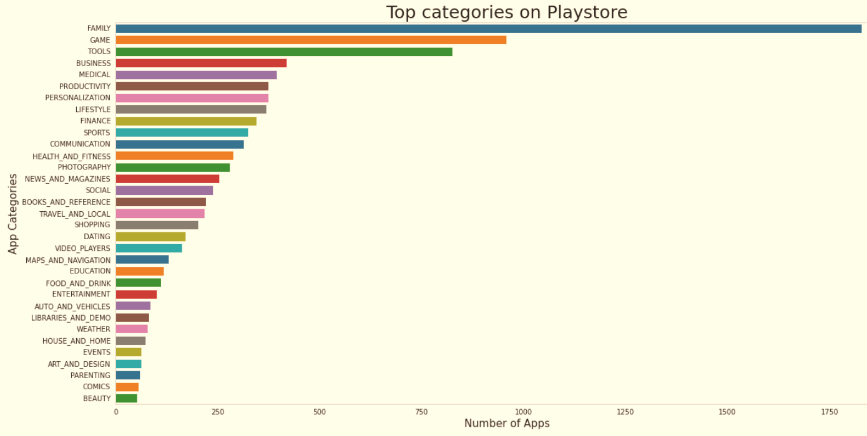
Count of Applications in each category
Family and Game apps have the
highest market prevalence. Surprising Tools, Business and Medical apps are also at the Top Count of applications.

Slide 15
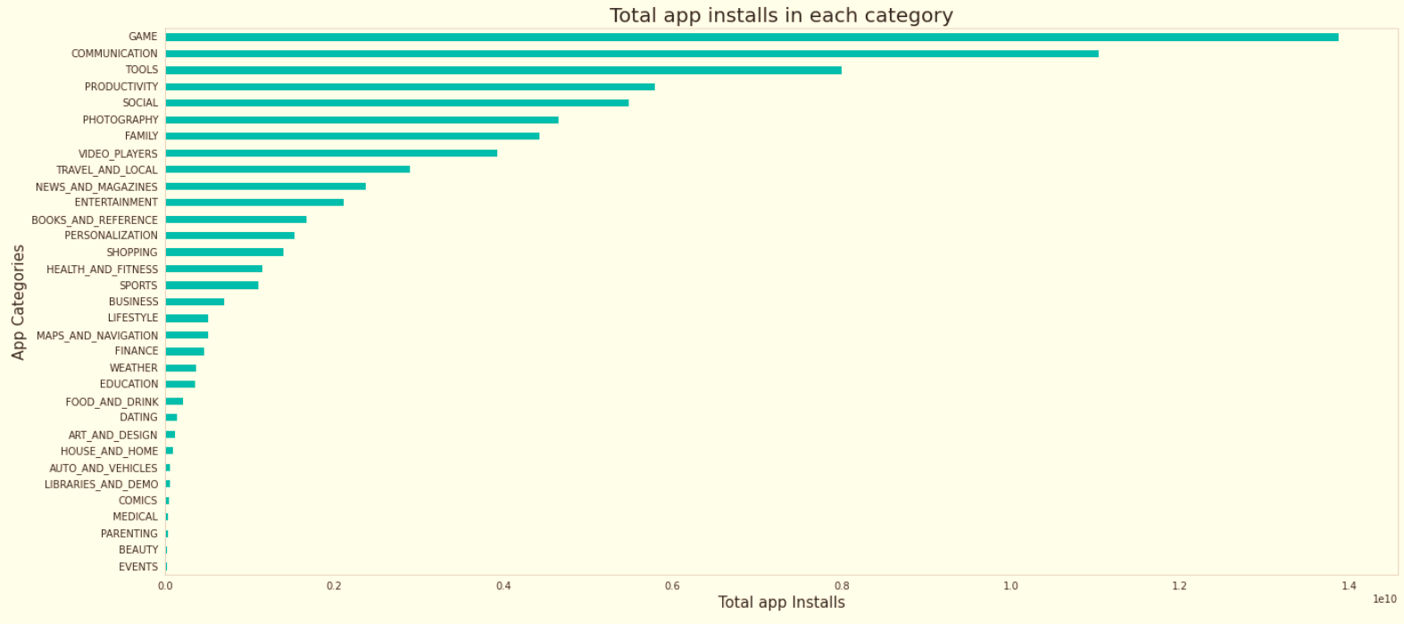
Category App's have most number of installs
The Game, Communication and Tools categories has the highest number of installs compared to other categories of apps.

Slide 16
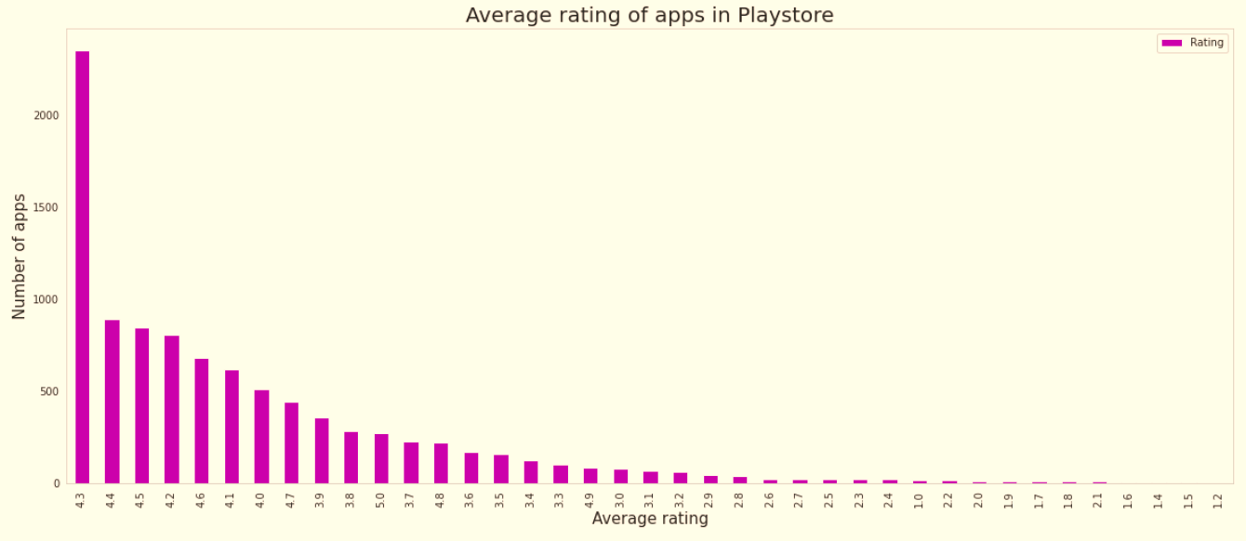
Average rating of the apps
The average user rating is divided into 4 categories:
Rating: 4-5 ⇒ Top Rated
Rating: 3-4 ⇒ Above Average
Rating: 2-3 ⇒ Average
Rating: 1-2 ⇒ Below Average
The majority of the apps in the Play Store (~80%) are top rated.
This implies that the majority of the users are happy with the services received via the respective app.

Slide 17
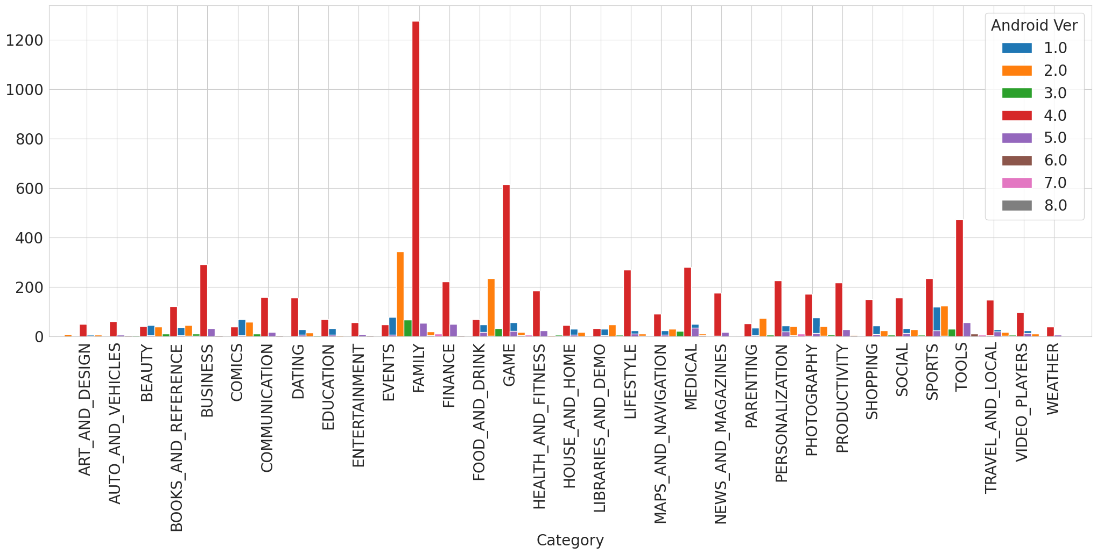
Android version based on each category

Slide 18
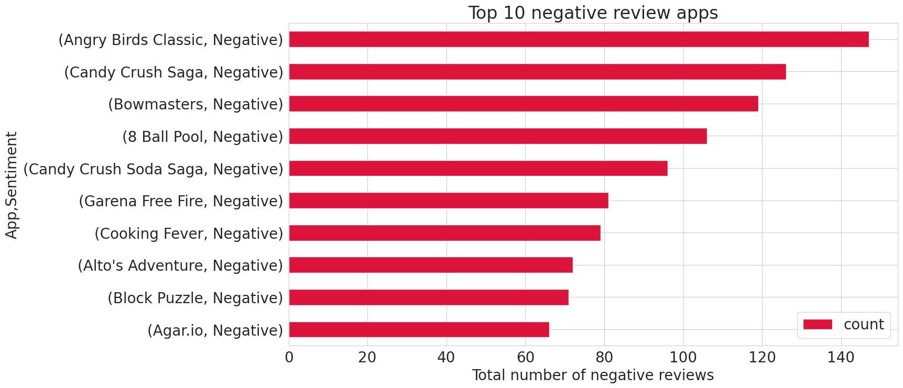
Negative Reviews
Angry Bird Classic is a app from merged dataset has highest 147 Negative sentiment count.

Slide 19
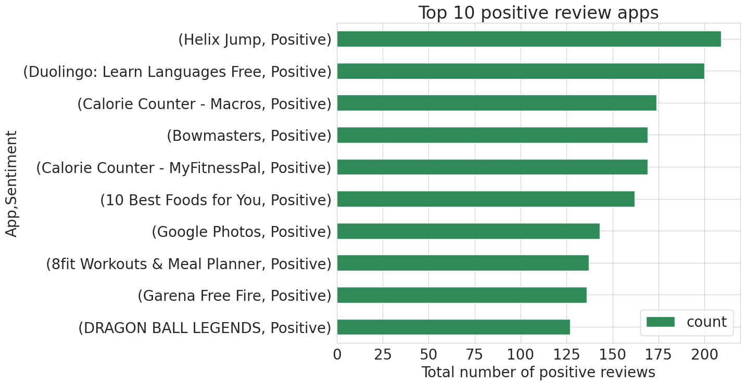
Positive Reviews
Helix Jump is a App from merged dataset has highest 209 Positive sentiment count.

Slide 20
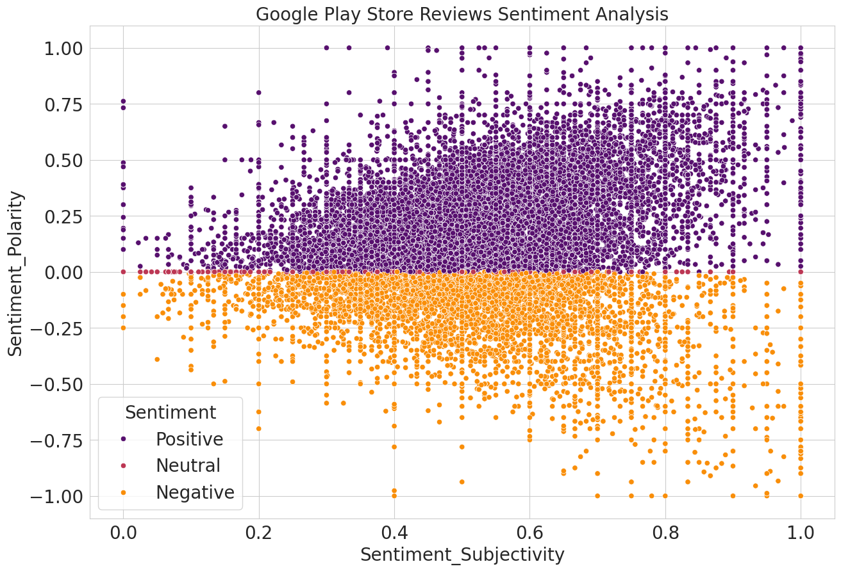
Helix Jump is a App from merged dataset has highest 209 Positive sentiment count.
From the above scatter plot it can be concluded that sentiment subjectivity is not always proportional to sentiment polarity but in maximum number of case, shows a proportional behavior, when variance is too high or low

Slide 21
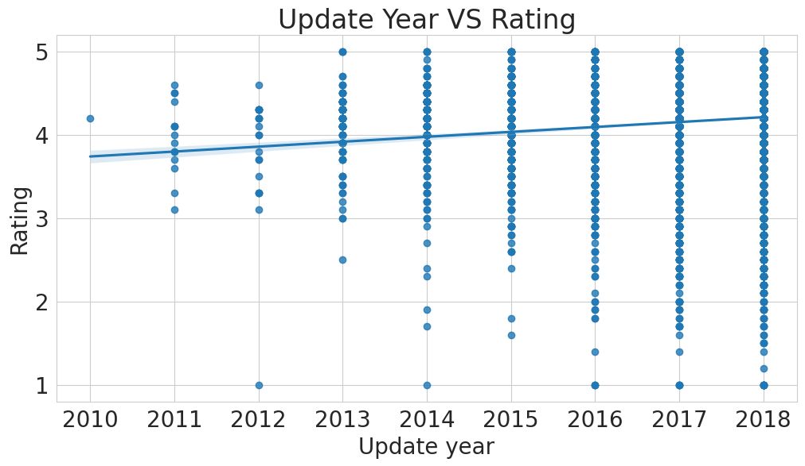
Update year & Rating

Slide 22
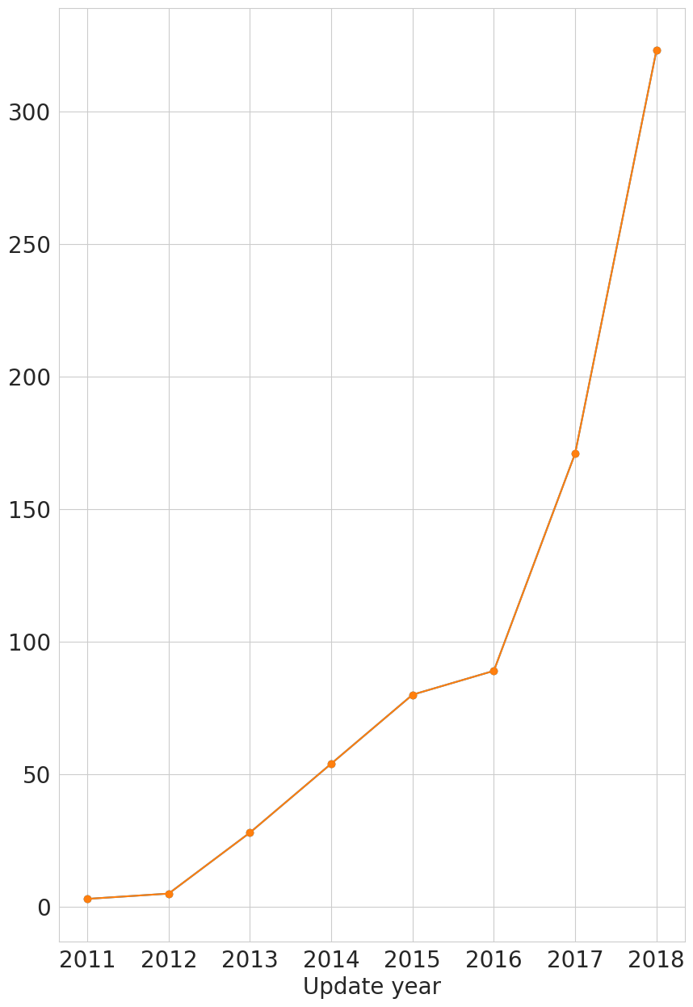
Does Last Update date has an effects on rating

Slide 23
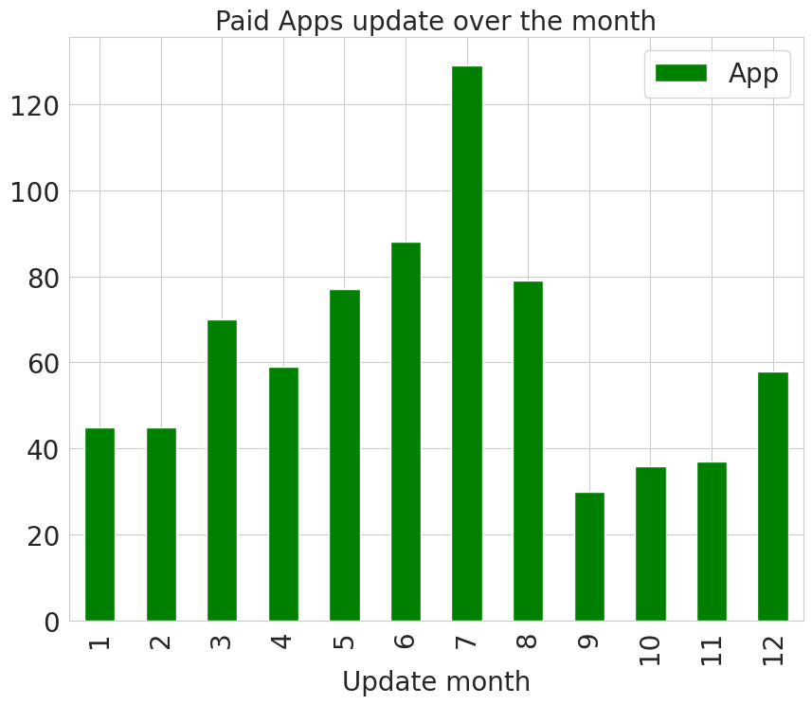
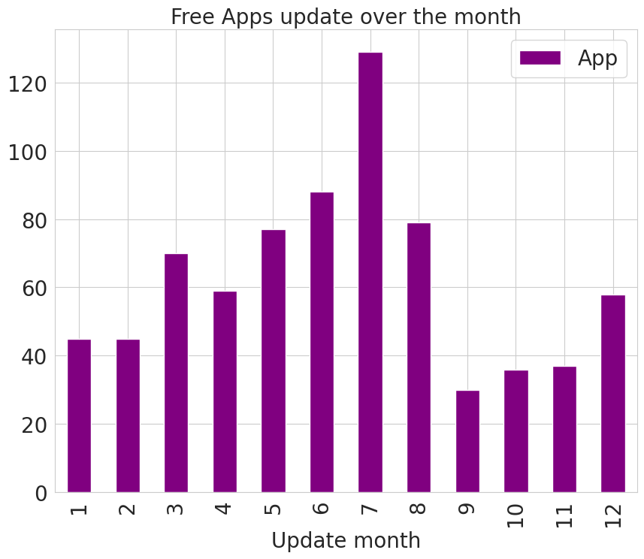
Distribution of Apps updated over the Year and Month

Slide 24
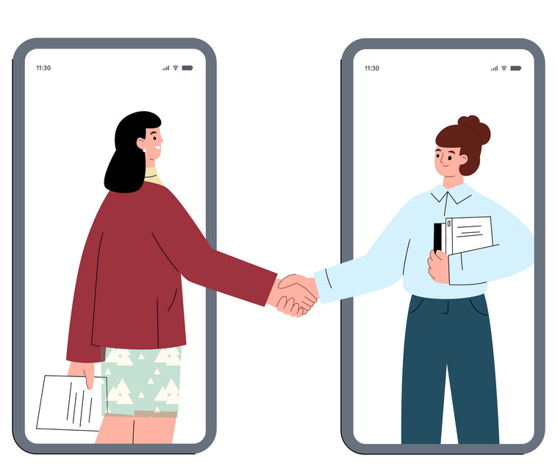
Conclusion’s
92.19% apps are Free and 7.81% apps are paid in type.
81.80% apps have Everyone content rating.
Events category has a highest mean rating of 4.39 and Dating category has lowest 4.05 rating.
Family, Game and Tools are top three categories having 1906, 926 and 829 app count.
Most competitive category: Family
Category with the highest number of installs: Game
Tools, Entertainment, Education, Business and Medical are top Genres.
8783 Apps are having size less than or equal to 50 MB.
7749 Apps has rating more than 4.0 including both type of app.
Overall sentiment count of merged dataset in which Positive sentiment count is 64%, Negative 22% and Neutral 14%.

Slide 25

Conclusion’s
It's good to develop a Free type app and having a content rating for Everyone.
Percentage of apps that are top rated = 81.80%
There are 20 free apps that have been installed over a billion times
Minecraft is the only app in the paid category with over 10M installs, and also has produced the most revenue only from installation fee.
Price, Rating, Size has no or very less correlation with Sentiment Polarity.
The median size of the apps in the play store is 12 MB
The apps whose size varies with device has the highest number average app installs.
The apps whose size is greater than 90 MB has the highest number of average user reviews, they are more popular than the rest.
Helix Jump has the highest number of positive reviews and Angry Birds Classic has the highest number of negative reviews

Slide 26


